Slide 1

Explainable AI-Driven Bone Tumor Detection Using Hybrid ResNet, EfficientNet, and ViT Models
Department of Computer Science and Engineering
Third Review
Presented by:
Madhumitha R
Shobana R
Shrimathi K
Vidhya G
Date: 06/03/26
Guided By
Mrs. Bhuvanesawari R (A/P CSE)

Slide 2
ABSTRACT
Bone tumor detection from medical images is essential for early diagnosis and effective treatment planning. Traditional CNN-based approaches often provide limited interpretability and may struggle to capture complex image features. This project proposes an explainable AI-driven hybrid deep learning framework that integrates ResNet-50, EfficientNet, and Vision Transformer (ViT) models for improved feature extraction and classification. Advanced preprocessing techniques such as CLAHE and morphological operations are applied to enhance image quality and highlight tumor regions. Grad-CAM visualization is incorporated to provide explainable insights, helping clinicians understand the model’s decision-making process and improving reliability in medical diagnosis.

Slide 3
INTRODUCTION
Bone tumors are abnormal growths of bone tissue that can be either benign or malignant, requiring early and accurate diagnosis to improve patient survival rates. Manual analysis of medical images is time-consuming and highly dependent on radiologist expertise, which may lead to diagnostic inconsistencies. Recent advancements in Artificial Intelligence (AI), particularly Deep Learning, have shown promising results in automating medical image analysis. However, many existing models lack transparency and struggle to generalize across diverse datasets. This project introduces an Explainable AI-driven hybrid deep learning framework to enhance accuracy, interpretability, and reliability in bone tumor detection.

Slide 4
PROBLEM STATEMENT
The detection and classification of bone tumors from MRI images is a challenging task that requires accurate analysis by medical experts.
Manual diagnosis can be time-consuming and may lead to errors due to the complexity of medical images.
Early identification of whether a tumor is benign, malignant, or absent is crucial for effective treatment planning.
However, traditional diagnostic methods rely heavily on radiologists and may not always provide quick results.
Therefore, there is a need for an automated system using deep learning techniques to assist in accurate and efficient bone tumor classification.

Slide 5
OBJECTIVE
The main objective of this project is to develop an automated system for bone tumor classification using deep learning techniques.
The system aims to accurately classify MRI images into Benign, Malignant, and No Tumor categories.
It also focuses on improving diagnostic accuracy by using advanced neural network models such as ResNet-50.
Another objective is to integrate the trained model with a Flask-based web application for easy image upload and prediction.
The system ultimately aims to assist medical professionals in faster and more reliable tumor detection.

Slide 6
SUMMARY OF LITERATURE
S.No | Title | Author | Year | Findings (6 words)
1 | Bone Tumor Detection Using CNN | Zhang et al. | 2019 | CNN improves early tumor classification
2 | Medical Image Analysis with ResNet | He et al. | 2018 | Deep residual networks enhance accuracy
3 | EfficientNet for Medical Imaging | Tan & Le | 2020 | Efficient scaling improves performance
4 | Vision Transformers in Healthcare | Dosovitskiy et al. | 2021 | ViT captures global image context
5 | Explainable AI in Medical Diagnosis | Selvaraju et al. | 2020 | Grad-CAM improves model interpretability

Slide 7
EXISTING SYSTEM
The existing system for bone tumor detection mainly relies on Convolutional Neural Networks (CNN) to analyze medical images and classify tumor presence.
Image preprocessing techniques such as OTSU thresholding are used to improve image clarity and identify the region of interest.
The processed images are then used to train the CNN model for detecting tumor patterns.
The system highlights suspected tumor areas to assist doctors in interpreting the results.
However, the approach achieves only moderate accuracy and lacks advanced feature extraction and explainability mechanisms.

Slide 8
DISADVANTAGES
Limited accuracy in complex tumor detection
Depends only on basic CNN architecture
Uses simple OTSU threshold preprocessing
Poor generalization on diverse datasets
Cannot capture global image features

Slide 9
PROPOSED SYSTEM
The proposed system introduces an explainable AI-driven framework for bone tumor detection using hybrid deep learning models.
It integrates advanced architectures such as ResNet-50, EfficientNet, and Vision Transformer (ViT) to improve feature extraction and classification accuracy.
Enhanced preprocessing techniques, including CLAHE and adaptive morphological operations, are applied to improve image quality and highlight tumor regions.
An ensemble approach is used to combine CNN and transformer-based models for better spatial and contextual understanding.

Slide 10
ADVANTAGES
Higher accuracy in bone tumor detection
Hybrid deep learning improves feature extraction
Uses advanced models (ResNet, EfficientNet, ViT)
Better image enhancement using CLAHE
Captures both local and global features

Slide 11
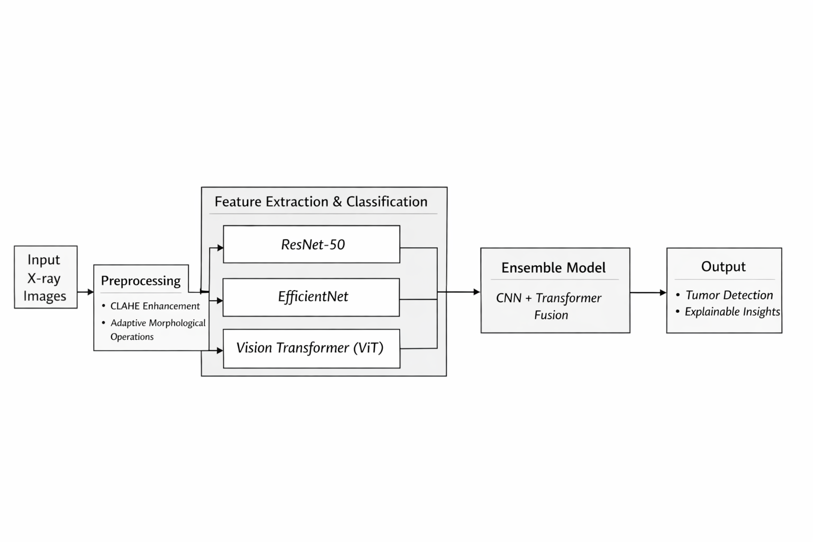
SYSTEM ARCHITECTURE

Slide 12
METHODOLOGY
Development Model
Deep learning-based development methodology is used for iterative model training, continuous evaluation, and performance optimization to improve bone tumor detection accuracy.
System Architecture
Medical Image Input → Image Preprocessing → Feature Extraction → Vision Transformer (ViT) Integration → Hybrid Classification Model → Detection Result Working Flow
User uploads bone X-ray or MRI image
System performs image preprocessing and enhancement
CLAHE improves contrast and highlights tumor region
Deep features extracted using ResNet-50 and EfficientNet
Vision Transformer analyzes global image patterns
Hybrid model classifies tumor or normal bone
Grad-CAM generates heatmap showing tumor location
Detection results displayed to the user

Slide 13
SYSTEM MODULES
Dataset Collection Module – Collects MRI bone images categorized as benign, malignant, and no tumor for model training.
Data Preprocessing Module – Enhances and resizes images to improve data quality for deep learning training.
Model Training Module – Trains the deep learning model (ResNet-50) to learn features and classify tumor types.
Prediction Module – Analyzes the uploaded MRI image and predicts the tumor category.
Web Application Interface Module – Provides a Flask-based interface for users to upload images and view prediction results.

Slide 14
SYSTEM REQUIREMENTS
HARDWARE REQUIREMENTS
Processor : Intel Core i5 / i7 processor or higher
RAM : 16 GB
Disk Space : 500 GB SSD
Display : Standard Monitor
SOFTWARE REQUIREMENTS
Operating System : Windows 10 / 11
Python : Python 3.8 or higher
Front End : HTML, CSS, JS
Database : MySQL / SQLite
Development Environment : VS Code

Slide 15
APPLICATIONS
Medical Diagnosis Support – Assists doctors in identifying bone tumors from MRI images.
Early Tumor Detection – Helps detect bone tumors at an early stage for better treatment planning.
Hospital Decision Support Systems – Can be integrated into hospital systems to support radiologists in diagnosis.
Medical Research – Useful for researchers studying tumor patterns using medical imaging.
Healthcare Automation – Enables automated analysis of MRI images to reduce manual workload for medical professionals.

Slide 16
LIMITATIONS
The system's accuracy depends on the quality and size of the training dataset.
The model may produce incorrect predictions if the MRI image quality is poor or unclear.
It can only classify images into benign, malignant, or no tumor, and cannot detect other medical conditions.
The system requires sufficient computational resources for training the deep learning model.

Slide 17
FUTURE SCOPE
The system can be improved by using larger and more diverse MRI datasets to increase prediction accuracy.
Advanced deep learning models can be integrated to achieve better tumor detection and classification performance.
The system can be expanded to detect different types of bone diseases and abnormalities.
Integration with hospital management systems and medical databases can enhance real-time clinical usage.
A mobile or cloud-based application can be developed to make the system accessible to doctors and healthcare centers anywhere.

Slide 18
PERFORMANCE AND RESULTS
The proposed system classifies bone tumor MRI images into Benign, Malignant, and No Tumor using a deep learning model based on the ResNet-50 architecture.
The model was trained using preprocessed and augmented MRI images to improve learning and generalization.
During evaluation, the model achieved an overall accuracy of about 95%, showing strong performance in distinguishing different tumor types.
Performance metrics such as precision, recall, and F1-score indicate reliable classification results.
The trained model is integrated with a Flask-based web application, allowing users to upload MRI images and receive instant tumor prediction with confidence scores.

Slide 19
CONCLUSION
This project proposes an advanced Explainable AI-based framework for bone tumor detection using hybrid deep learning architectures.
By integrating ResNet, EfficientNet, and Vision Transformers with enhanced preprocessing and visualization techniques, the system addresses limitations of existing methods.
The proposed solution aims to deliver higher accuracy, interpretability, and reliability, making it a valuable clinical decision-support tool for early bone tumor diagnosis.

Slide 20
THANK YOU

